Slide 1
Internet Of Things
Presented By
Gayathiri Shriram
Madhushri Kanathoor Subramanya Bhat

Slide 2
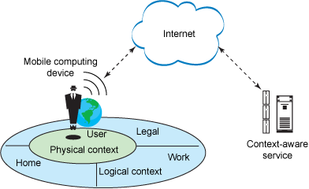
Context Awareness

Slide 3
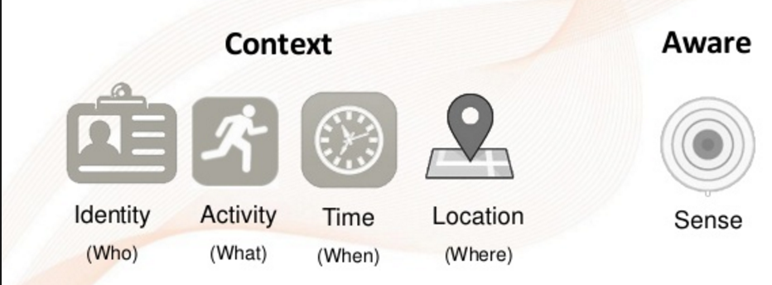
Context Aware Systems

Slide 4
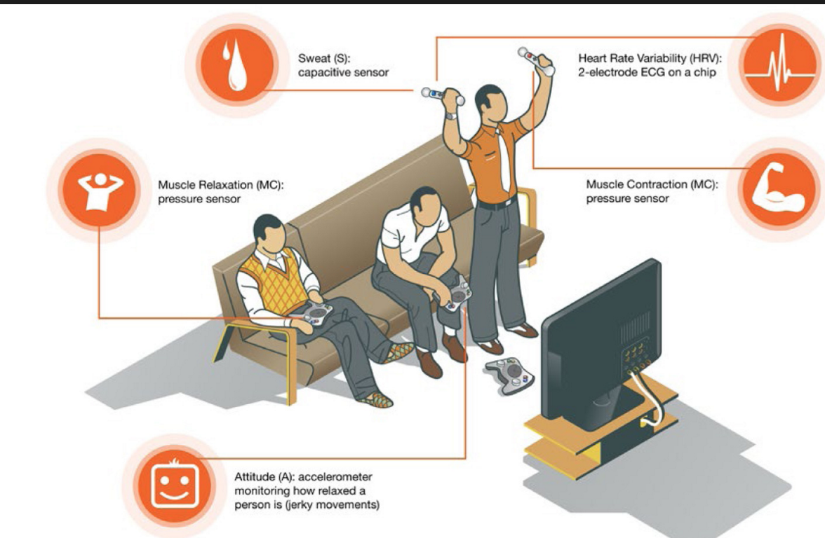
Context Awareness - Sensing

Slide 5
Strategies Used by IoT Products
Context Aware Tagging Section
Context selection
Context presentation

Slide 6
Analytical Applications
Developing analytical applications for the IoT is a complex process that needs diverse knowledge of domains, sensors, algorithms, programming, and deployment infrastructure.
Possible Solution - model-driven development (MDD) framework
Crowdsourcing sensing data

Slide 7
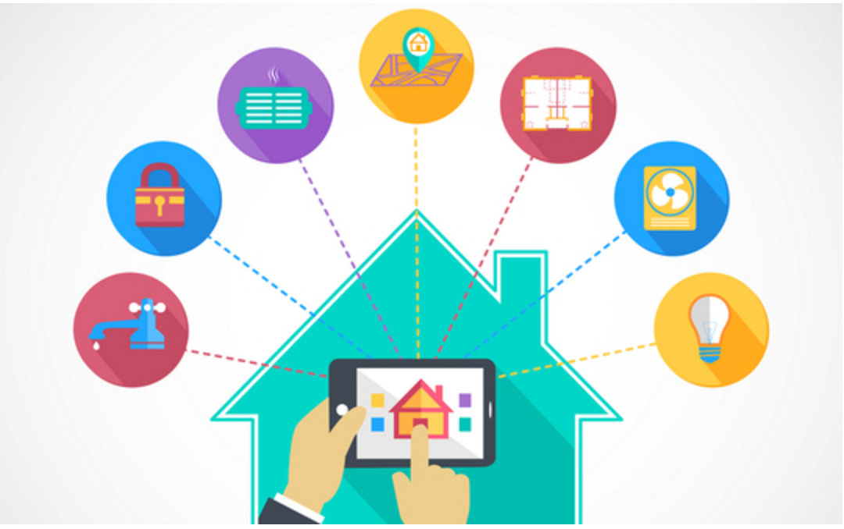
Project – Home Automation System

Slide 8
Project Requirements
Hardware : Raspberry Pi 2 / B+.
USB wifi dongle.
HDMI monitor and cable.
Micro USB power adapter (smartphone charger).
PIR motion sensor.

Slide 9
Project Requirements
Breadboard.
BC547 transistor.
5V SPDT relay and 1n4001 diode.
LED and 220Ohm resistor.
Software - Raspbian OS

Slide 10
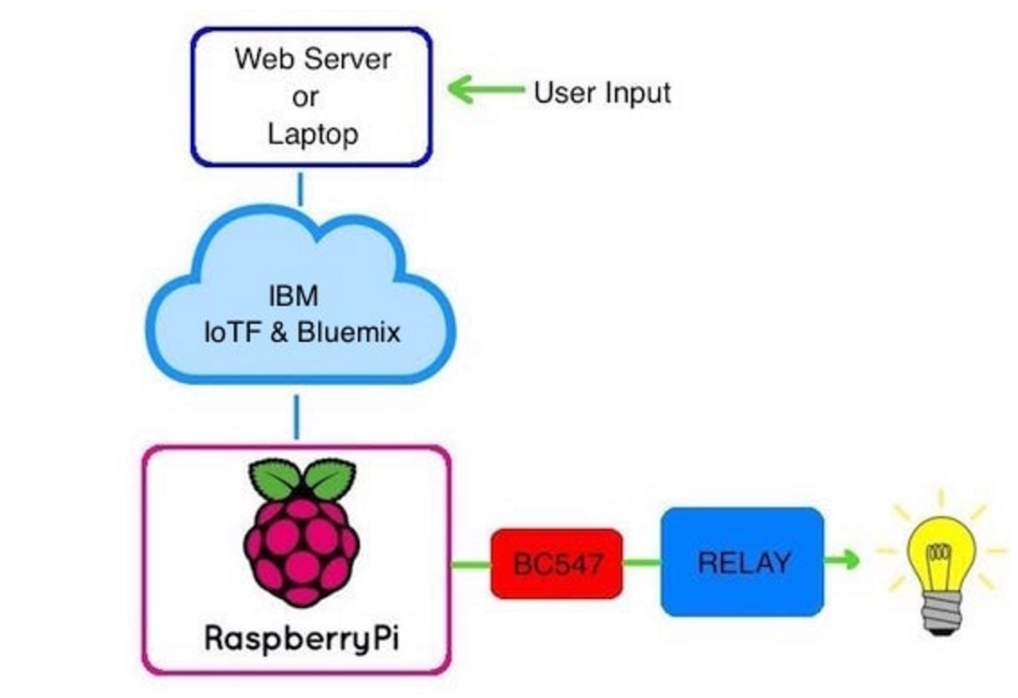
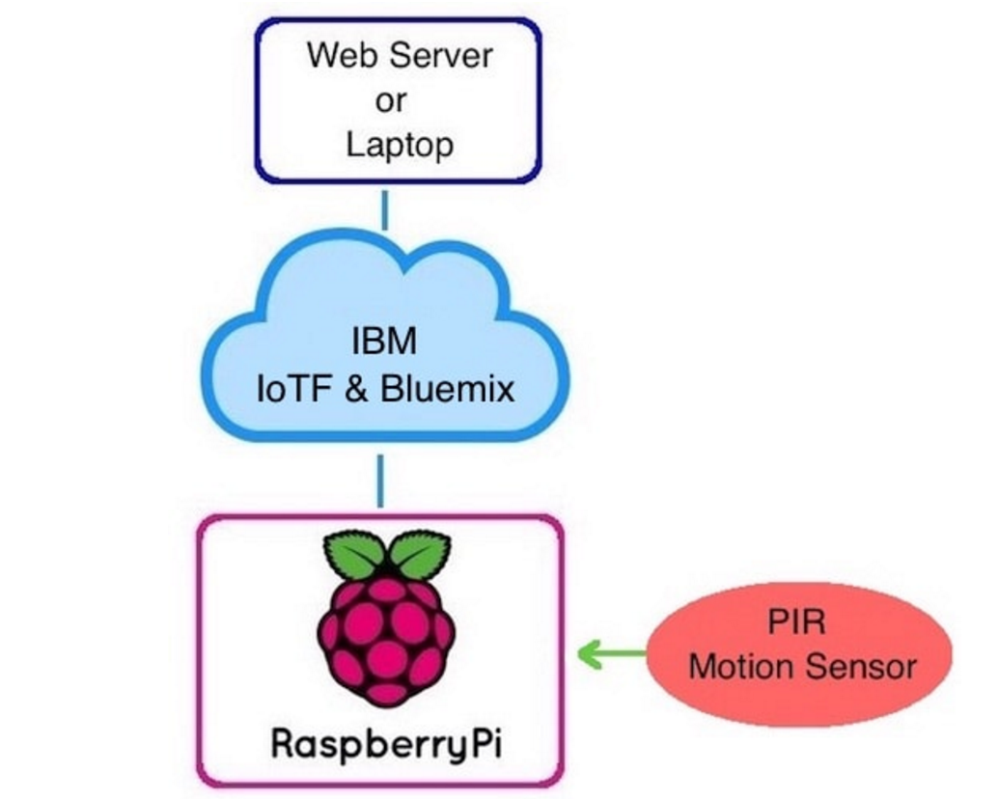
Sending and Receiving Data

Slide 11
Thank You

